Slide 1

Optimizing Neural Network Weights & Architecture Using Evolutionary Algorithm
Research Methodology - Dr. Jinan Fiaidhi
Group 6
Kadakia, Avish (1132452)
Bhatti, Manpreet (1142587)

Slide 2
Contents
02
Hyper parameter tuning the nightmare …
Normal Approach
Proposed Implementation
Building Blocks
Demo
Where do we go from here ?

Slide 3
Hyper parameter tuning the nightmare ..
03

Slide 4
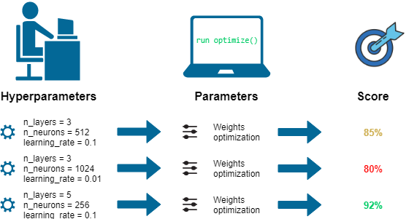
04
Neural Network Possible Hyper Parameters
Learning Rate
Optimizer
Optimizer Parameters
Batch Size
Loss function
Model depth
Activation Functions
Hidden Nodes

Slide 5
How is it done normally?
05

Slide 6
06
If accuracy is not as per expectation GUESS and change hyper parameters and model architecture again to hopefully get better results
Train model using back propagation for several epochs to get accuracy
GUESS appropriate hyper parameters, activation functions and model architecture.
Select a dataset

Slide 7
What was the plan?
07

Slide 8

It is a design principle noted by the U.S. Navy in 1960. The KISS principle states that most systems work best if they are kept simple rather than made complicated; therefore, simplicity should be a key goal in design, and unnecessary complexity should be avoided.

Slide 9
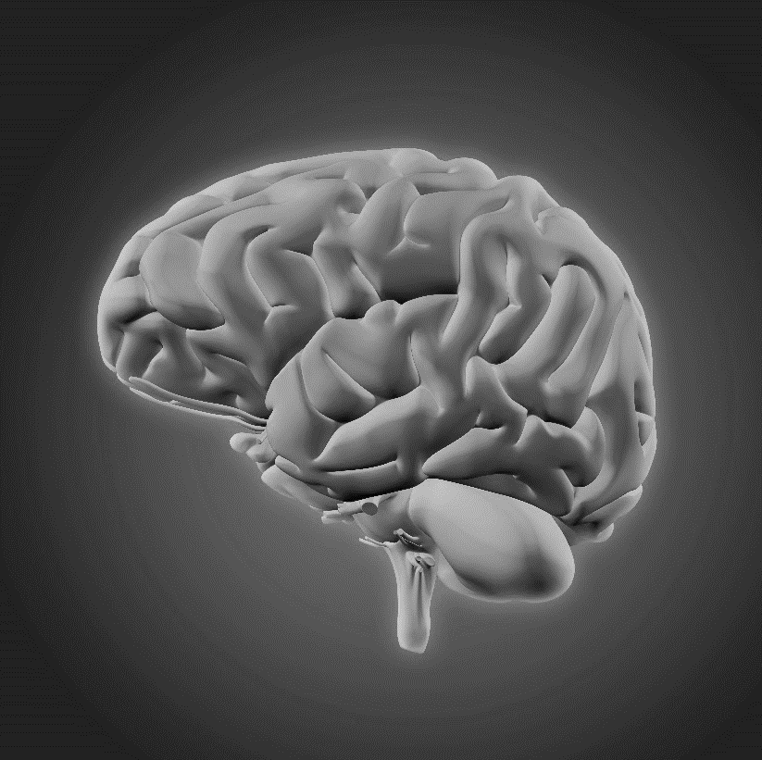
09
Model architectures and weights will be randomly generated
Best model architecture will be sent to the user with it’s training / testing accuracy
Upload Dataset
Dataset and configuration file will be uploaded to the server for further processing
Pertained weights for the best model will also be sent to the user after training completed
Select input and output size
Multiple networks will compete against each other for the same task and get optimized over several generations

Slide 10
Building Blocks
010

Slide 11







011

Slide 12
Demo …
012

Slide 13
Where do we go from here ?
013

Slide 14






014
Support for different networks
Worldwide Access
Support for multiple types of network such as CNN, RNN and LSTMs can be added my making modifications to the current layout
Deploy the application on the internet using a hosting service and several virtual machines. This will enable the user to access the system from anywhere in the world
Multiple Layer Support
Informative UI
Currently only sequential layers are being optimized but in future optimization for different types of layers such as dropout layers or batch normalization can also be added
The UI currently has no progress indication or easy way to visualize dataset uploaded this and many other features can also be added

Slide 15
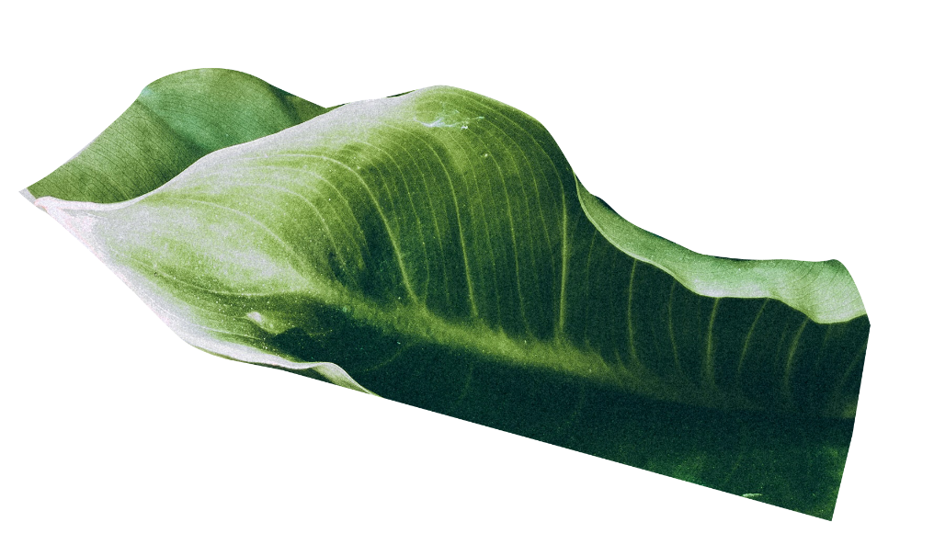






015
THANK YOU

